Slide 1
CCNA 200-301, Volume I
Chapter 15
Operating Cisco Routers

Slide 2
Objectives
Installing Cisco Routers
Enabling IPv4 Support on Cisco Router

Slide 3
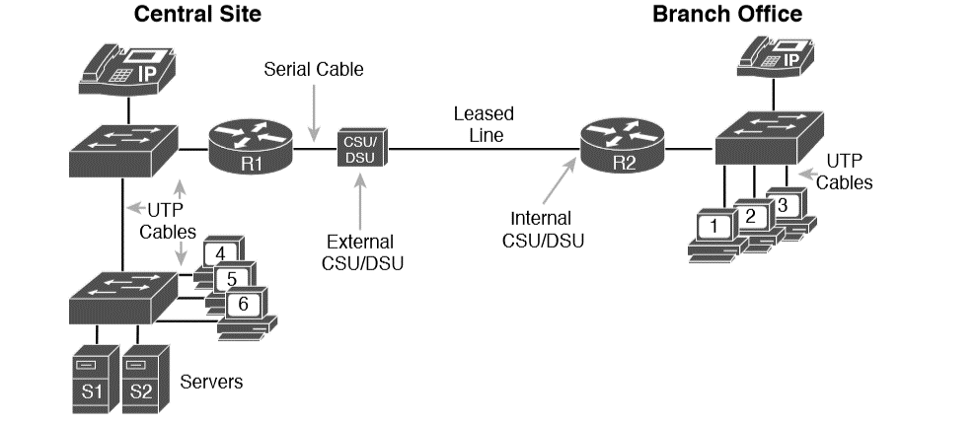
Cabling Diagram of an Enterprise Network

Slide 4
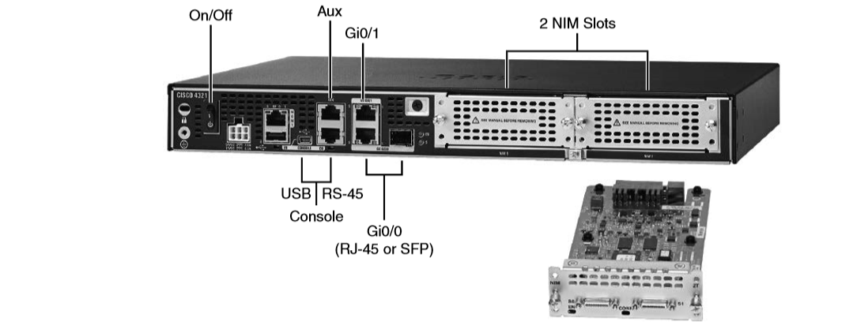
Photos of a Model 4321 Cisco Integrated Services Router (ISR)

Slide 5
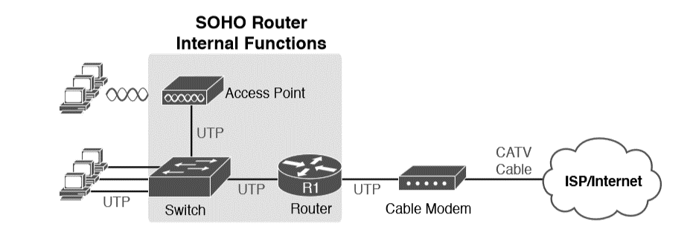
Devices in a SOHO Network with High-Speed CATV Internet

Slide 6
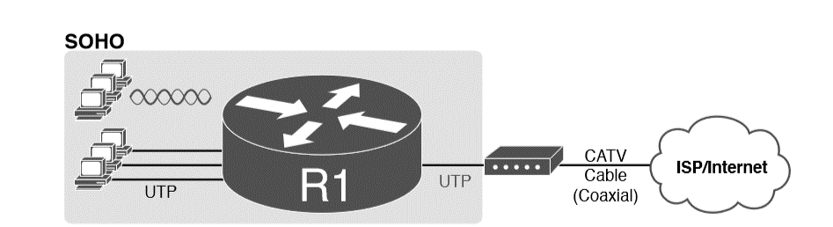
SOHO Network, Using Cable Internet and an Integrated Device

Slide 7
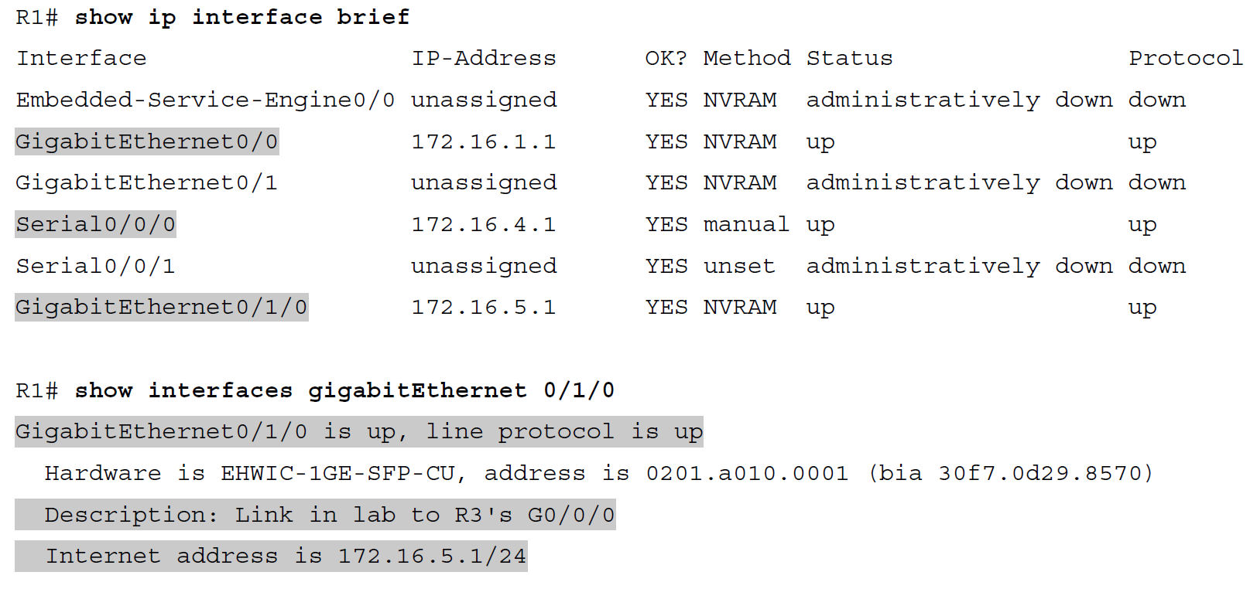
Listing the Interfaces in a Router

Slide 8
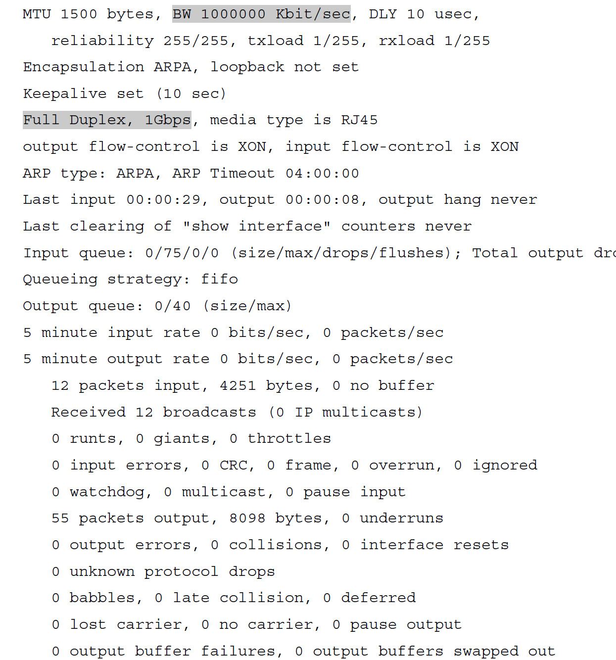
Listing the Interfaces in a Router (Continued)

Slide 9
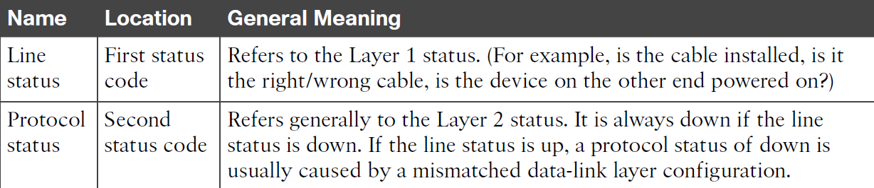
Interface Status Codes

Slide 10
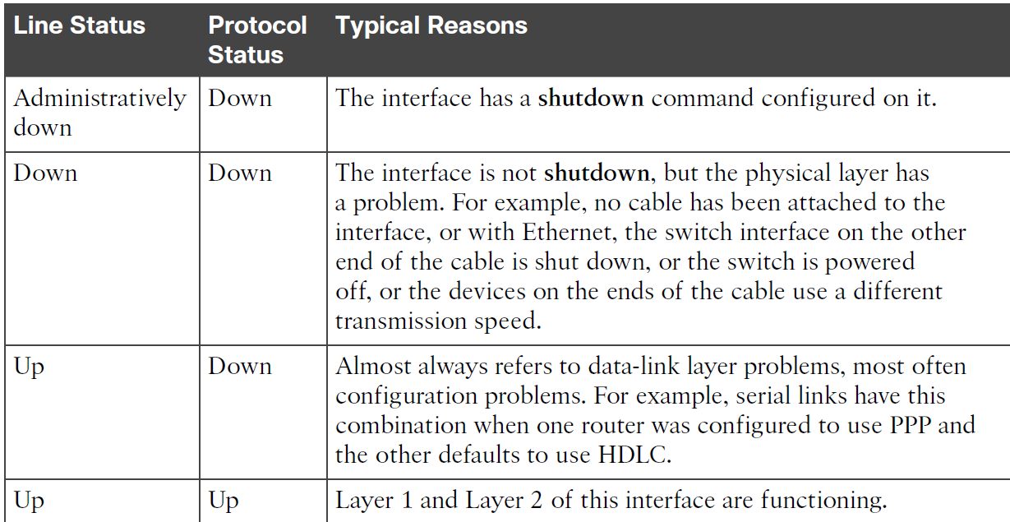
Typical Combinations of Interface Status Codes

Slide 11
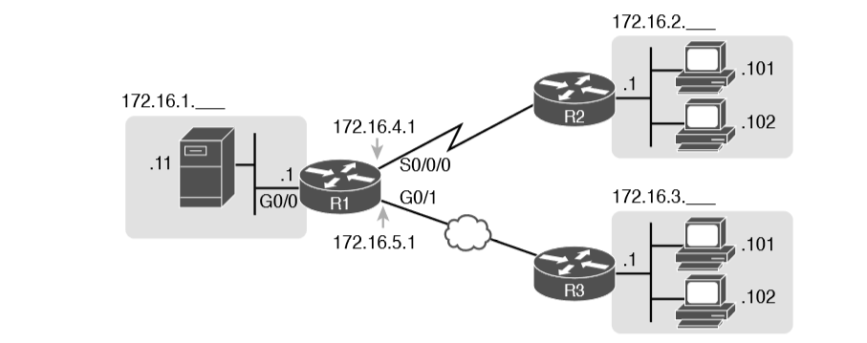
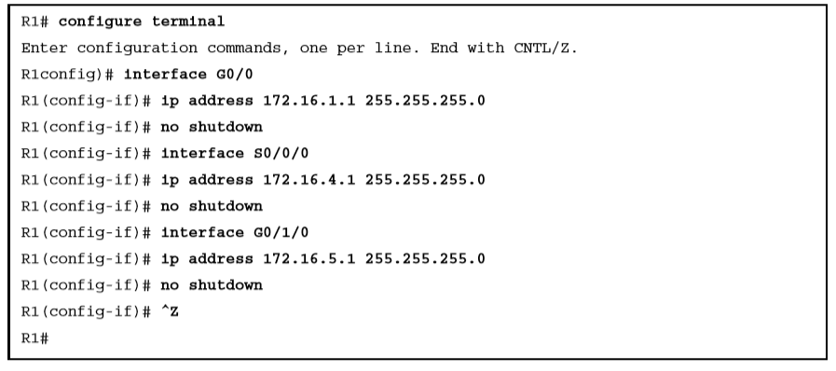
Configuring IP Addresses on Cisco Routers

Slide 12
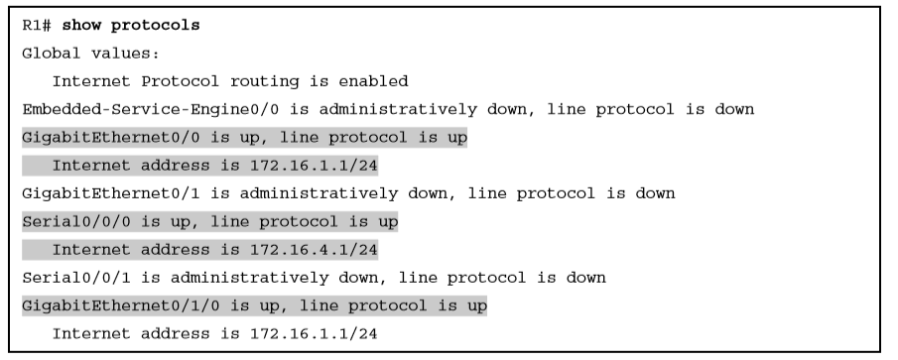
Verifying IP Addresses on Cisco Routers

Slide 13
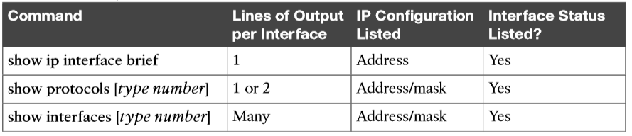
Key Commands to List Router Interface Status

